Slide 1
Chapter 3 Expressions and Interactivity
Starting Out with C++ from Control Structures through Objects, Tony Gaddis, 9th Edition
ENGR 1400 – Dr. Michael E. Olson

Slide 2
3.1
The cin Object

Slide 3
The cin Object
Standard input object
Like cout, requires iostream file
Used to read input from keyboard
Information retrieved from cin with >>
<< is the stream insertion operator
>> is the stream extraction operator
Input is stored in one or more variables
Program 3_1_Input.cpp

Slide 4
The cin Object
cin converts data to the type that matches the variable:
int height;
cout << "How tall is the room? ";
cin >> height;

Slide 5
Displaying a Prompt
A prompt is a message that instructs the user to enter data.
You should always use cout to display a prompt before each cin statement. cout << "How tall is the room? "; cin >> height;
Add \n or endl to force the input on the next line

Slide 6
The cin Object
Can be used to input more than one value:
cin >> height >> width;
Multiple values from keyboard must be separated by spaces
Order is important: first value entered goes to first variable, etc.

Slide 7
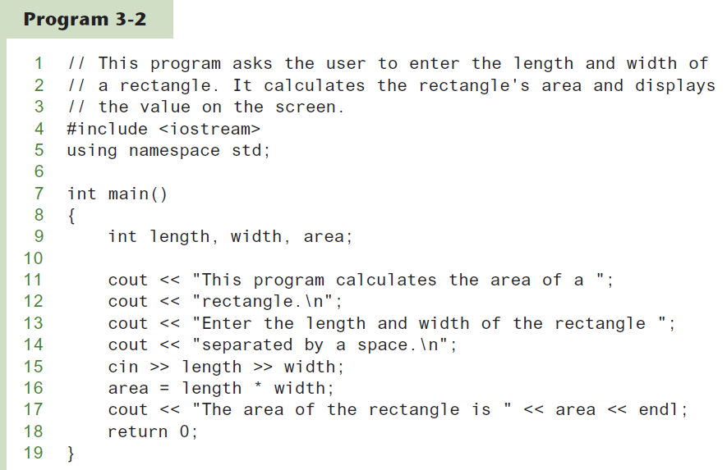
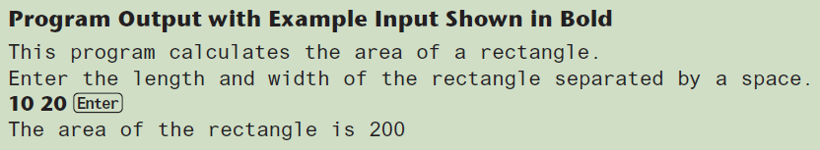
Using cin To Read Multiple Values

Slide 8
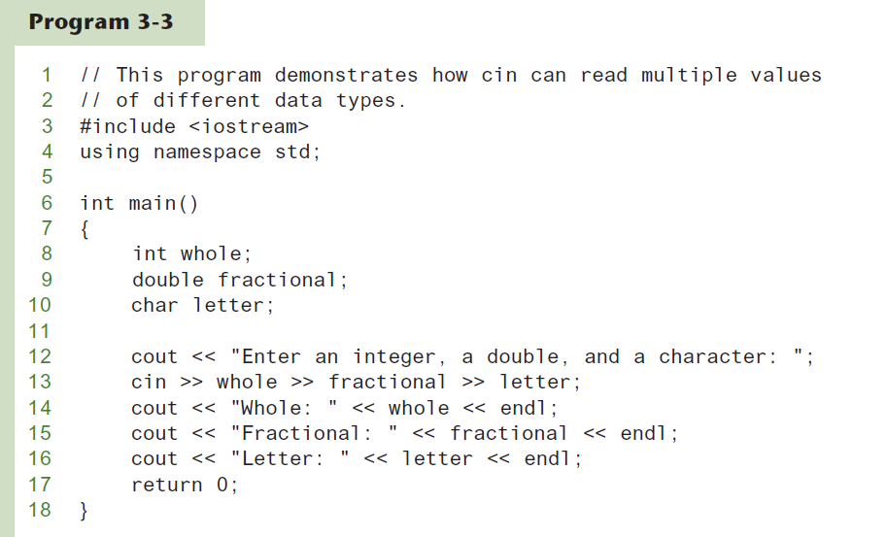
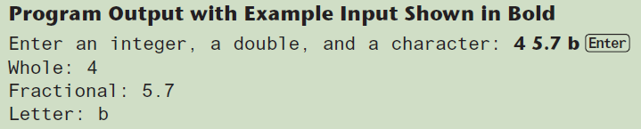
Using cin To Read Values of Different Data Types

Slide 9
Using cin To Read Multiple Values
cin >> float >> int >> char ;
The keyboard buffer
Why not a comma ( , ) ?
What if this were the input for
cin >> int >> float >> char ;
5 | . | 7 |  | 4 |  | b | [Enter]

Slide 10
3.2
Mathematical Expressions

Slide 11
Mathematical Expressions
Can create complex expressions using multiple mathematical operators
An expression can be a literal, a variable, or a mathematical combination of constants and variables
Can be used in assignment, cout, other statements:
area = 2 * PI * radius;
cout << "border is: " << 2*(l+w);

Slide 12
Order of Operations
In an expression with more than one operator, evaluate from highest to lowest precedence:
- (unary negation), in order, left to right
* / %, in order, left to right
+ -, in order, left to right
In the expression 2 + 2 * 2 – 2
evaluate
second
evaluate
first
evaluate
third

Slide 13
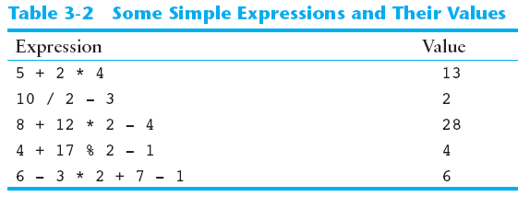
Order of Operations

Slide 14
Associativity of Operators
- (unary negation) associates right to left
*, /, %, +, - associate left to right
parentheses ( ) can be used to override the order of operations:
2 + 2 * 2 – 2 = 4
(2 + 2) * 2 – 2 = 6
2 + 2 * (2 – 2) = 2
(2 + 2) * (2 – 2) = 0

Slide 15
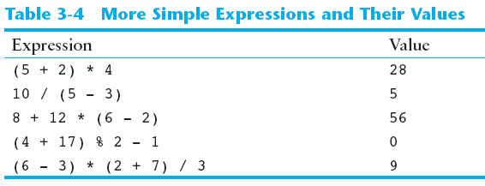
Grouping with Parentheses

Slide 16
Algebraic Expressions
Multiplication requires an operator:
Area=lw is written as Area = l * w;
There is no exponentiation operator:
Area=s² is written as Area = pow(s, 2);
Parentheses may be needed to maintain order of operations:
is written as
m = (y2-y1) /(x2-x1);

Slide 17
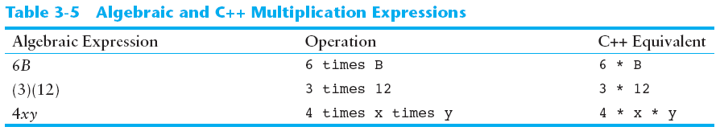
Algebraic Expressions

Slide 18
3.3
When You Mix Apples with Oranges: Type Conversion

Slide 19
When You Mix Apples with Oranges: Type Conversion
Operations are performed between operands of the same type.
If not of the same type, C++ will convert one to be the type of the other
This can impact the results of calculations.

Slide 20
Hierarchy of Types
Ranked by largest number they can hold
Highest: long double
double
float
unsigned long
long
unsigned int
Lowest: int
In some cases, sizeof(long) == sizeof(int)
In this case, unsigned int > long

Slide 21
Type Coercion
Type Coercion: automatic conversion of an operand to another data type
Promotion: convert to a higher type
Demotion: convert to a lower type

Slide 22
Coercion Rules
1) char, short, unsigned short automatically promoted to int
2) When operating on values of different data types, the lower one is promoted to the type of the higher one.
pay = hours * payrate
? = 15 * 7.50
3) When using the = operator, the type of expression on right will be converted to type of variable on left

Slide 23
3.4
Overflow and Underflow

Slide 24
Overflow and Underflow
Occurs when assigning a value that is too large (overflow) or too small (underflow) to be held in a variable
Variable contains value that is ‘wrapped around’ set of possible values
Different systems may display a warning/error message, stop the program, or continue execution using the incorrect value

Slide 25
Overflow
1 byte:
0 1 1 1 1 1 0 0 124
+ 1 0 1 1 1 1 1 0 1 125
+ 1 0 1 1 1 1 1 1 0 126
+ 1 0 1 1 1 1 1 1 1 127
+ 1 1 0 0 0 0 0 0 0 -128
+ 1 1 0 0 0 0 0 0 1 -127
+ 1 1 0 0 0 0 0 1 0 -126

Slide 26
Underflow
1 byte:
1 0 0 0 0 0 1 1 -125
- 1 1 0 0 0 0 0 1 0 -126
- 1 1 0 0 0 0 0 0 1 -127
- 1 1 0 0 0 0 0 0 0 -128
- 1 0 1 1 1 1 1 1 1 127
- 1 0 1 1 1 1 1 1 0 126
- 1 0 1 1 1 1 1 0 1 125

Slide 27
3.5
Type Casting

Slide 28
Type Casting
Used to manually promote/demote data types
Useful for floating point division using ints: double m; m = static_cast<double>(y2-y1)/(x2-x1);
Useful to see int value of a char variable:
char ch = 'C';
cout << ch << " is " << static_cast<int>(ch);

Slide 29
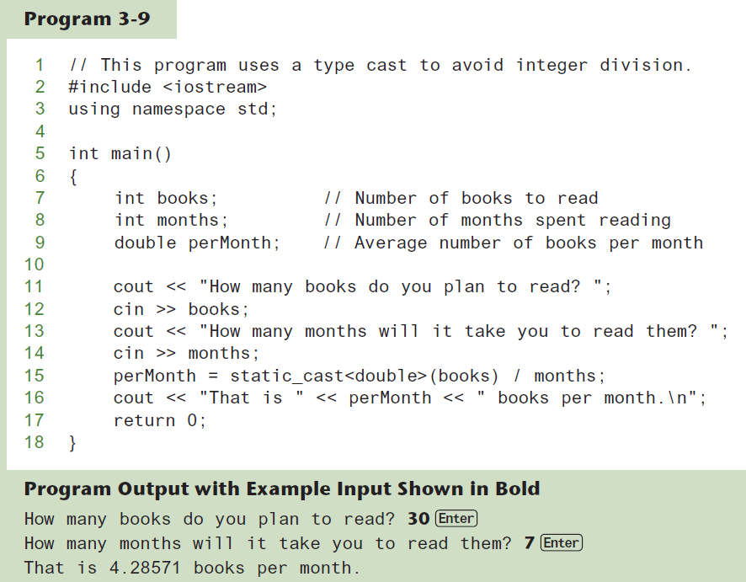
Type Casting

Slide 30
C-Style and Prestandard Type Cast Expressions
C-Style cast: data type name in ()
cout << ch << " is " << (int)ch;
Prestandard C++ cast: value in ()
cout << ch << " is " << int(ch);
Both are still supported in C++, although static_cast is preferred

Slide 31
3.6
Multiple Assignment and Combined Assignment

Slide 32
Multiple Assignment and Combined Assignment
The = can be used to assign a value to multiple variables:
x = y = z = 5;
Value of = is the value that is assigned
Associates right to left:
x = (y = (z = 5));
value
is 5
value
is 5
value
is 5

Slide 33
Combined Assignment
Look at the following statement:
sum = sum + 1;
This adds 1 to the variable sum.

Slide 34
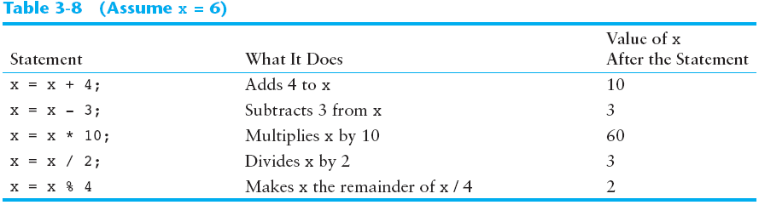
Other Similar Statements

Slide 35
Combined Assignment
The combined assignment operators provide a shorthand for these types of statements.
The statement
sum = sum + 1;
is equivalent to
sum += 1;

Slide 36
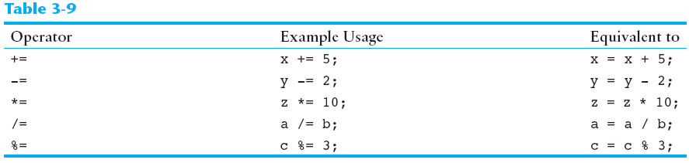
Combined Assignment Operators

Slide 37
Combined Assignment Operators
x = 20;
a = 5;
What is the value of:
x *= a + 5;
x = x * (a + 5);
x = 20 * (5 + 5);
x = 20 * 10;
x = 200;

Slide 38
3.7
Formatting Output

Slide 39
Formatting Output
Can control how output displays for numeric, string data:
size
position
number of digits
Requires iomanip header file

Slide 40
Stream Manipulators
Used to control how an output field is displayed
Some affect just the next value displayed:
setw(x): print in a field at least x spaces wide. Use more spaces if field is not wide enough

Slide 41
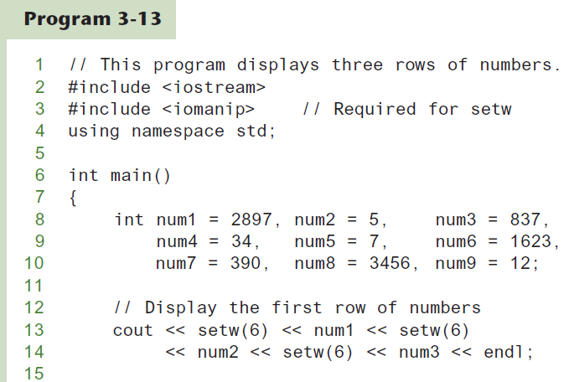
The setw Stream Manipulator
Continued…

Slide 42
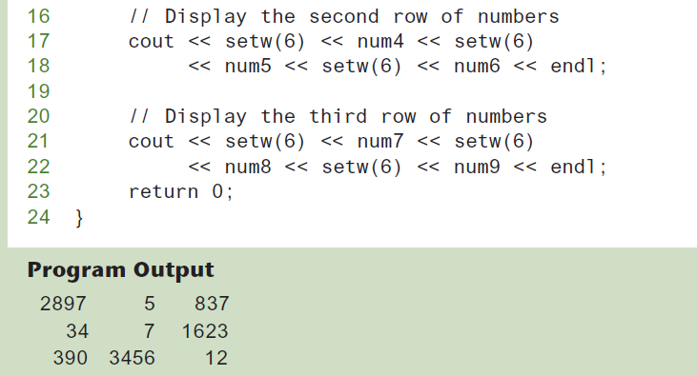
The setw Stream Manipulator

Slide 43
Stream Manipulators
Some affect values until changed again:
fixed: use decimal notation for floating-point values
setprecision(x): when used with fixed, print floating-point value using x digits after the decimal. Without fixed, print floating-point value using x significant digits
showpoint: always print decimal for floating-point values

Slide 44
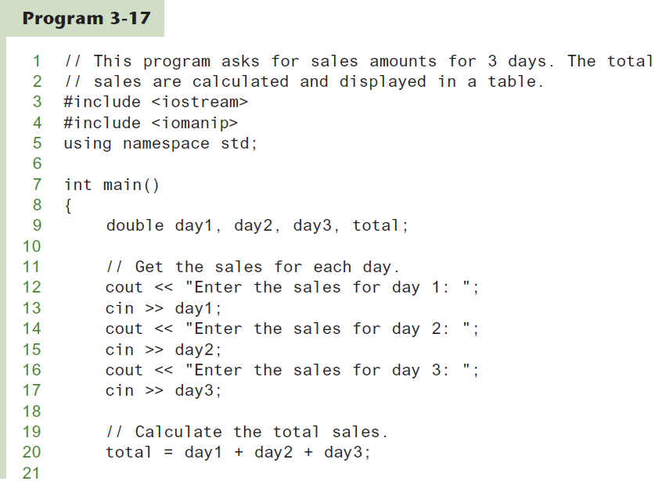
More Stream Manipulators
Continued…

Slide 45
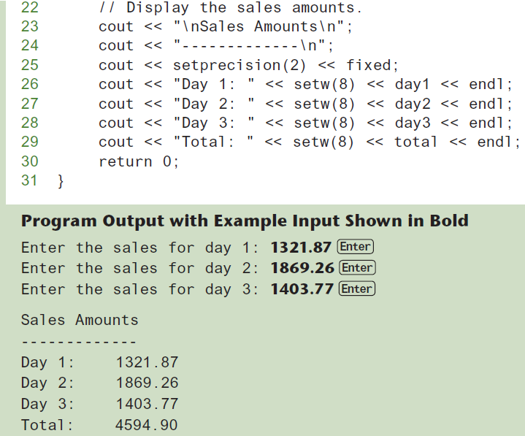
More Stream Manipulators

Slide 46
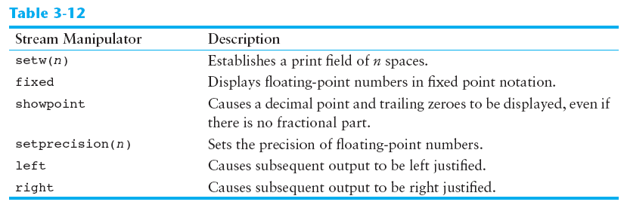
Stream Manipulators

Slide 47
3.8
Working with Characters and string Objects

Slide 48
Working with Characters and string Objects
Using cin with the >> operator to input strings can cause problems:
It passes over and ignores any leading whitespace characters (spaces, tabs, or line breaks)
To work around this problem, you can use a C++ function named getline.

Slide 49
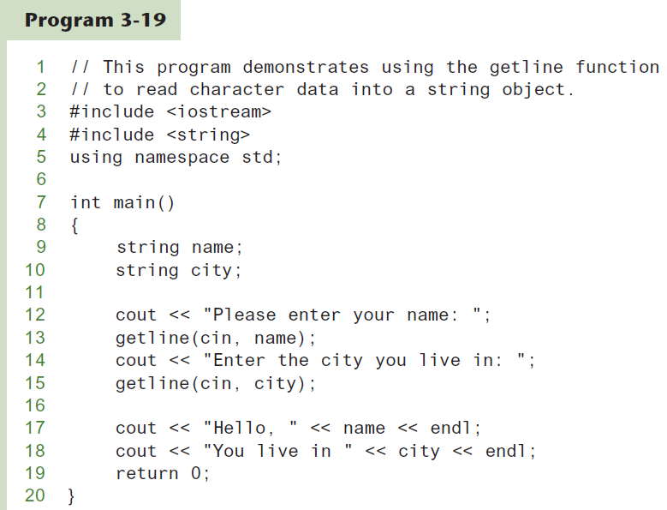
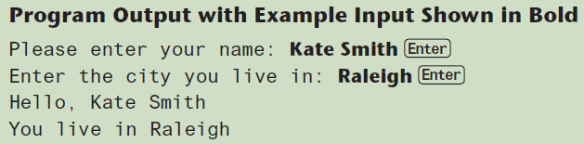
Using getline in Program 3-19

Slide 50
Working with Characters and string Objects
To read a single character:
Use cin:
char ch;
cout << "Strike any key to continue";
cin >> ch;
Problem: will skip over blanks, tabs, <CR>
Use cin.get():
cin.get(ch);
Will read the next character entered, even whitespace

Slide 51
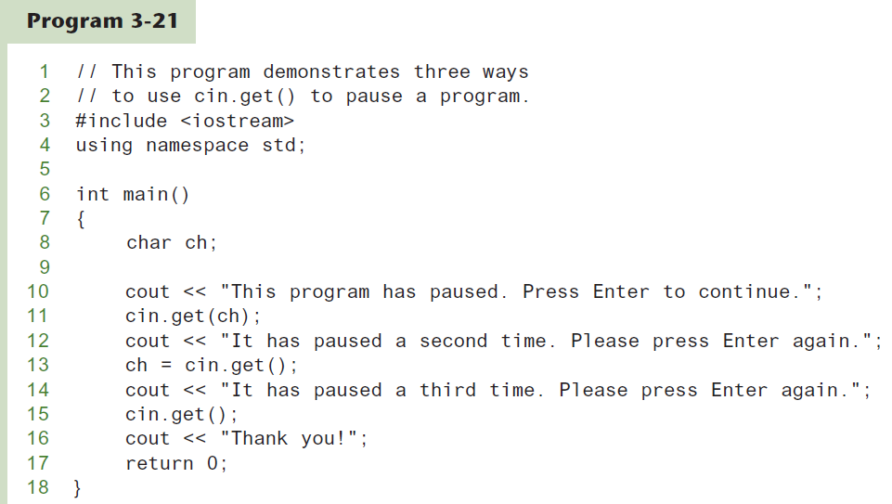
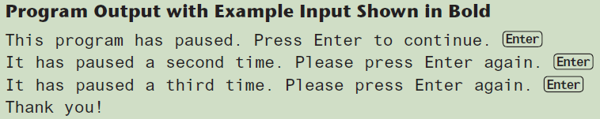
Using cin.get()

Slide 52
Working with Characters and string Objects
Mixing cin >> and cin.get() in the same program can cause input errors that are hard to detect
To skip over unneeded characters that are still in the keyboard buffer, use cin.ignore():
// skip next char cin.ignore(); // skip the next 10 chars or until '\n'
cin.ignore(10, '\n');

Slide 53
string Member Functions and Operators
To find the length of a string:
string state = "Texas";
int size = state.length();
To concatenate (join) multiple strings:
greeting2 = greeting1 + name1;
greeting1 = greeting1 + name2;
Or using the += combined assignment operator:
greeting1 += name2;

Slide 54
3.9
More Mathematical Library Functions

Slide 55
More Mathematical Library Functions
Require cmath header file
Take double as input, return a double
Commonly used functions:
sin | Sine
cos | Cosine
tan | Tangent
sqrt | Square root
log | Natural (e) log
abs | Absolute value (takes and returns an int)

Slide 56
More Mathematical Library Functions
These require cstdlib header file
rand(): returns a random number (int) between 0 and the largest int the compute holds. Yields same sequence of numbers each time program is run.
srand(x): initializes random number generator with unsigned int x

Slide 57
Random Numbers
Random numbers are useful in many applications, such as
Games and simulations
Statistical analysis
Data encryption

Slide 58
Generating Random Numbers
Use this #include statement: #include <random>
Create the following objects:
A random number engine to generate a random sequence of bits
A distribution object to format the bits into numbers of a specific data type, within a specified range

Slide 59
Generating Random Numbers
Example: Generate a random integer in the range 0-100: random_device myEngine; uniform_int_distribution<int> randomInt(0, 100); int number = randomInt(myEngine);

Slide 60
Generating Random Numbers
Example: Generate a random integer in the range 0-100: random_device myEngine; uniform_int_distribution<int> randomInt(0, 100); int number = randomInt(myEngine);
Creates a random number engine
named myEngine

Slide 61
Generating Random Numbers
Example: Generate a random integer in the range 0-100: random_device myEngine; uniform_int_distribution<int> randomInt(0, 100); int number = randomInt(myEngine);
Creates a distribution object
named randomInt

Slide 62
Generating Random Numbers
Example: Generate a random integer in the range 0-100: random_device myEngine; uniform_int_distribution<int> randomInt(0, 100); int number = randomInt(myEngine);
Generates a random int in the range 0-100 and assigns it to number

Slide 63
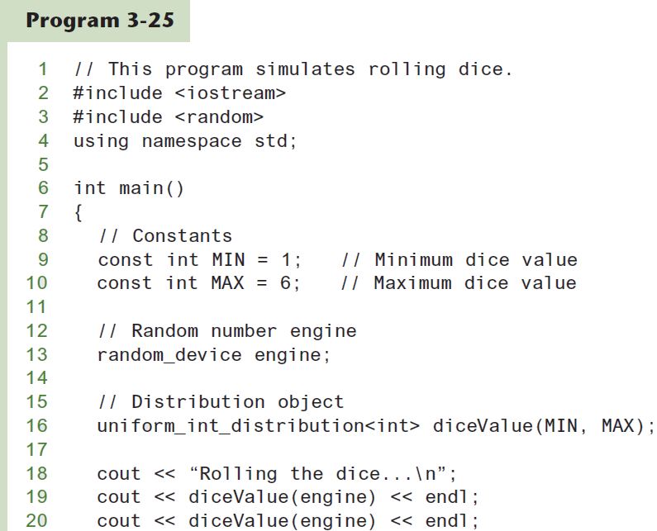
Simulating Dice
Continued…

Slide 64
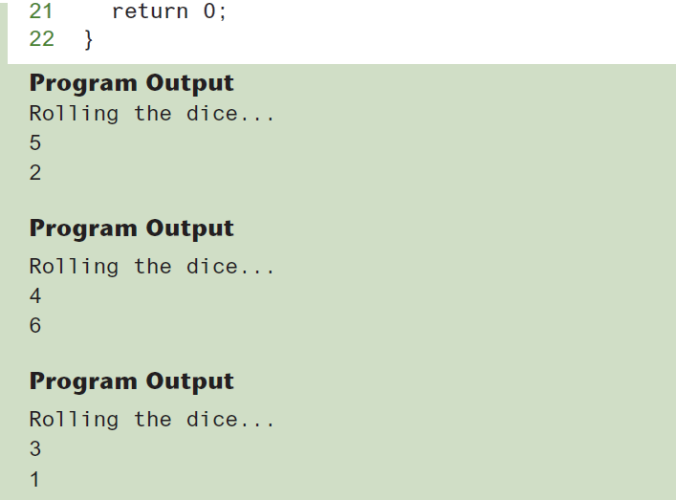
Simulating Dice

Slide 65
3.10
Hand Tracing a Program

Slide 66
Hand Tracing a Program
Hand trace a program: act as if you are the computer, executing a program:
step through and ‘execute’ each statement, one-by-one
record the contents of variables after statement execution, using a hand trace chart (table)
Useful to locate logic or mathematical errors

Slide 67
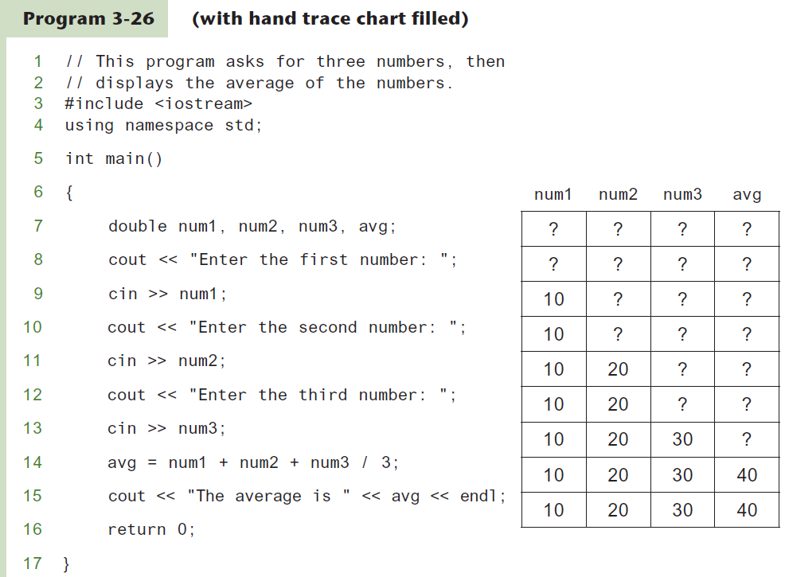
Program 3-26 with Hand Trace Chart

Slide 68
3.11
A Case Study

Slide 69
A Case Study
General Crates, Inc. builds custom-designed wooden crates.
You have been asked to write a program that calculates the:
Volume (in cubic feet)
Cost
Customer price
Profit of any crate GCI builds

Slide 70
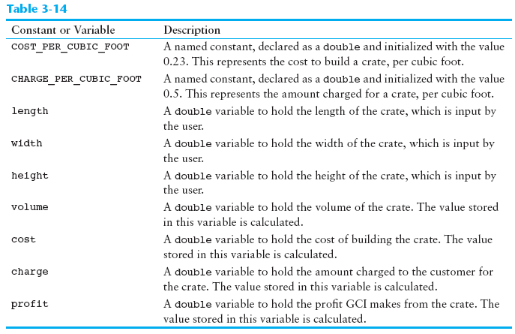
Variables

Slide 71
Program Design
The program must perform the following general steps:
Step 1:
Ask the user to enter the dimensions of the crate
Step 2:
Calculate:
the crate’s volume
the cost of building the crate
the customer’s charge
the profit made
Step 3:
Display the data calculated in Step 2.

Slide 72
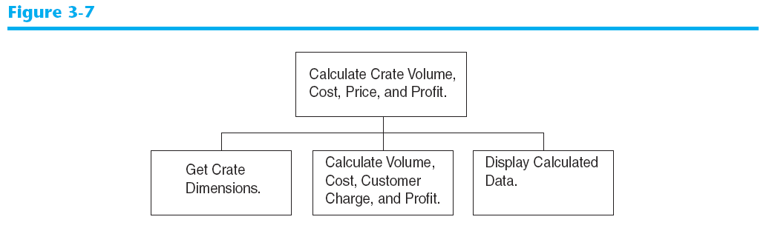
General Hierarchy Chart

Slide 73
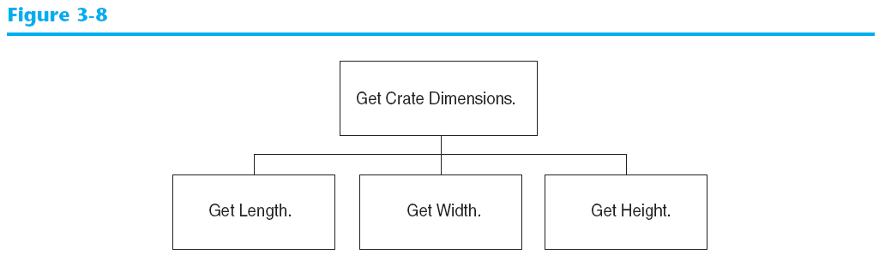
Get Crate Dimensions

Slide 74
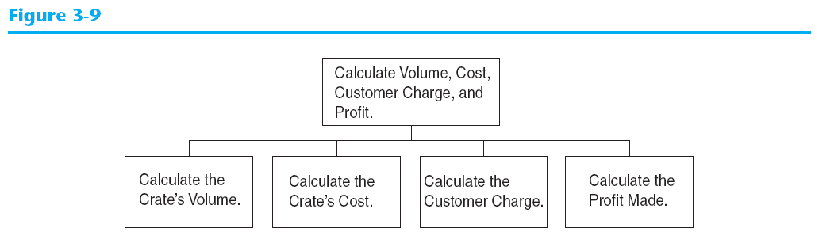
Calculate Volume, Cost, Customer Charge, and Profit

Slide 75
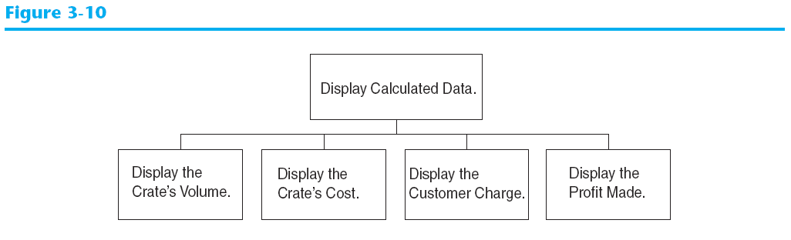
Display Calculated Data

Slide 76
Psuedocode
Ask the user to input the crate's length.
Ask the user to input the crate's width.
Ask the user to input the crate's height.
Calculate the crate's volume.
Calculate the cost of building the crate.
Calculate the customer's charge for the crate.
Calculate the profit made from the crate.
Display the crate's volume.
Display the cost of building the crate.
Display the customer's charge for the crate.
Display the profit made from the crate.

Slide 77
Calculations
The following formulas will be used to calculate the crate’s volume, cost, charge, and profit:
volume = length × width × height
cost = volume × 0.23
charge = volume × 0.5
profit = charge − cost

Slide 78
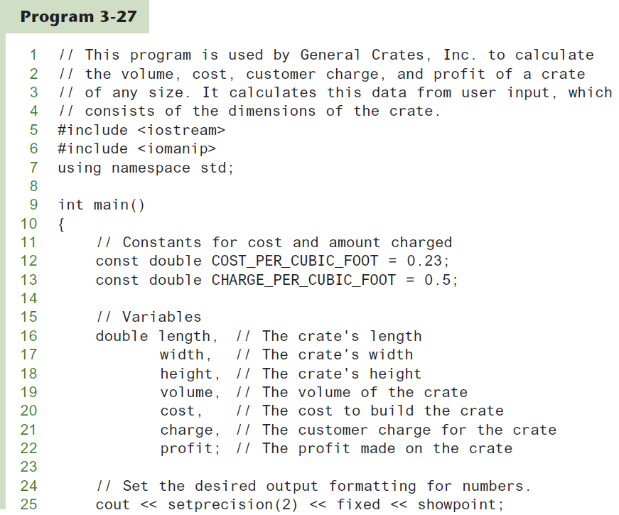
The Program
Continued…

Slide 79
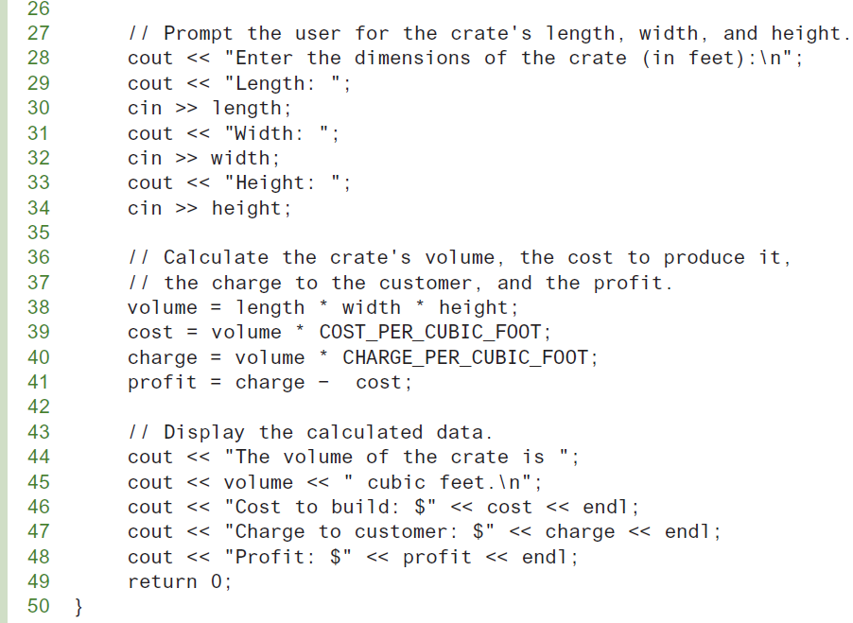
The Program
Continued…

Slide 80
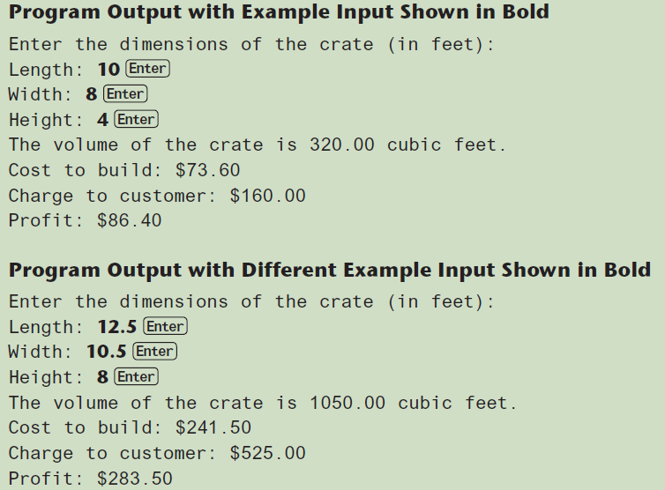
The Program

